Slide 1

Mental Health in Tech
Submitted by
Nisha pagare (20070243017)
Piyusha more(20070243015)
Adhibhan S. j(20070243041)
Vinay Wadhwa(2007023040)
Girish narsinghani(20070243016)

Slide 2







Flowchart of project
introduction
Disscussion and Survey
Government Policys on Survey
Data collection and methodology
Prediction and Data analysis
Conclusions

Slide 3
Introduction
Mental health is not just the absence of mental Disorder. It’s defined as a state of well-being in which the individuals realize their own abilities, can cope with the normal stresses of life, can work productively and fruitfully, and are able to make a positive contribution to their community.
However, studies performed on this topic focus on the general workplace. The technology sector is growing rapidly in size and in influence. Just within the United States alone, computer and information technology occupations are projected to grow 12% from 2018 to 2028, adding 546,000 jobs which is a rate much higher than the average for all occupations . With such a large industry employing millions of people, a strong focus should be 1 placed on understanding mental health and providing the right benefits to those who are dealing with mental illnesses. OSMI board members and volunteers bring their time and expertise to bear on this important issue by organizing efforts to change experiences of those with mental health disorders in the tech workplace.
The covid-19 during lockdown, had a negative impact on physical as well as mental health. People are afraid of dying, of losing their loved ones, they feel too alone, their jobs are losing etc, reason of internal migrant workers in India the entire nation was the victim of stringent measures to spread of corona Virus in the form of travel restriction and lockdowns. this survey conducted by Telephonic interviews.

Slide 4
Common Mental Health Terms
addiction is a chronic brain disease that causes compulsive substance use despite harmful consequences
alcohol and substance use disorders refer to the overuse of alcohol or drugs leading to effects that are detrimental to the individual’s physical and mental health
depression is a common and serious medical illness that causes feelings of sadness and/or a loss of interest in activities once enjoyed; it can lead to a variety of emotional and physical problems
The cultural bias that makes seeking treatment difficult includes eating disorders being viewed as a feminine problem, misconceptions about what constitutes an eating disorder, and a major stigma around men seeking help for psychological issues.

Slide 5

Data collection and Methodology
The dataset is from a 2014 survey conducted by Open Sourcing Mental Illness (OSMI) and can be downloaded here. The survey is conducted online at the OSMI website and the OSMI team intends to use these data to help drive awareness and improve conditions for individuals with mental illness in the IT workplace. It should be noted that as this is an online survey, it may be prone to voluntary response bias and may cause over representation of data.
The dataset contains 900 rows with responses of people who participated in Survey. This survey examined people based on 27 factors (columns) that might associate with the mental health status.
This dataset contains the following variables: Age, Gender, Number of employees,
Benefits, Physical and mental health etc.

Slide 6

Data processing and data cleaning
The tool python was used for data pre-processing and cleaning purpose. In python there are different packages this project used pandas and NumPy for data cleaning processing. We use these packages to remove the unwanted fields. We check this by looking into the dataset and finding the fields which has a lot of non-available entries. By this we remove the field “timestamp”, “state”,” comments”. Later we find a lot of cleaning process to be executed in the gender field.
The first part of data cleaning involves cleaning up of the Gender variable. Based on the responses, there are 49 unique entries of gender. We will divide these values into four main categories: Male, Female, Gender Queer and Transgender.
If we check for missing values in the dataset, we observe that most of the missing values are in the comments variable. A few missing values are also present in the self-employed and work interfere variables.

Slide 7
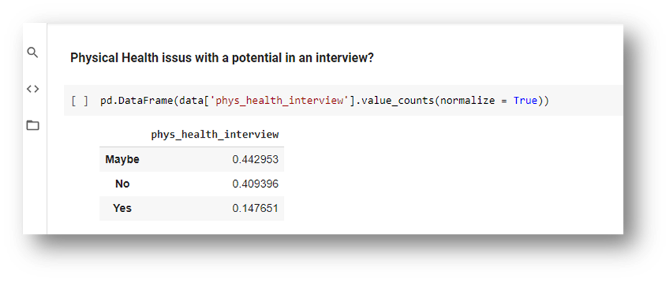
Data analysis on survey
We tried to understand the dataset and gather knowledge from the study, we used three field in the dataset “treatment” which is our label and the features ”remote work” and “Self-employed” with respect to countries.
Physical Health issue with a potential employer in an interview
In the below image we show how the survey ranges
for the question whether the question
of physical illness is asked and we normalise the answers
May be – 44%
No 40

Slide 8
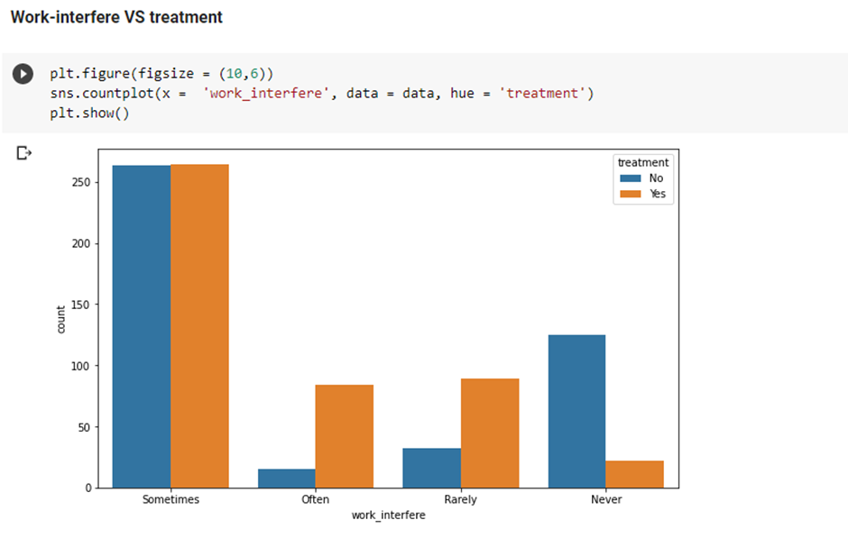
Data analysis on survey
The below image shows the thoughts of people, how they think
taking a mental illness treatment will affect their working time.
This fig is show us analysis between
Work-interfere VS Treatment
Employee work sometime
Other employee is no interfere and no treatment

Slide 9


Data Visualisation
Data visualization is the graphical representation of information and data. By using visual elements like charts, graphs, and maps,
Country-wise representation of data with focus on India Gender ratio participating in the Survey
to achieve this purpose we use a distribution plot and we can see that the survey is skewed towards the left that is in the region of age

Slide 10
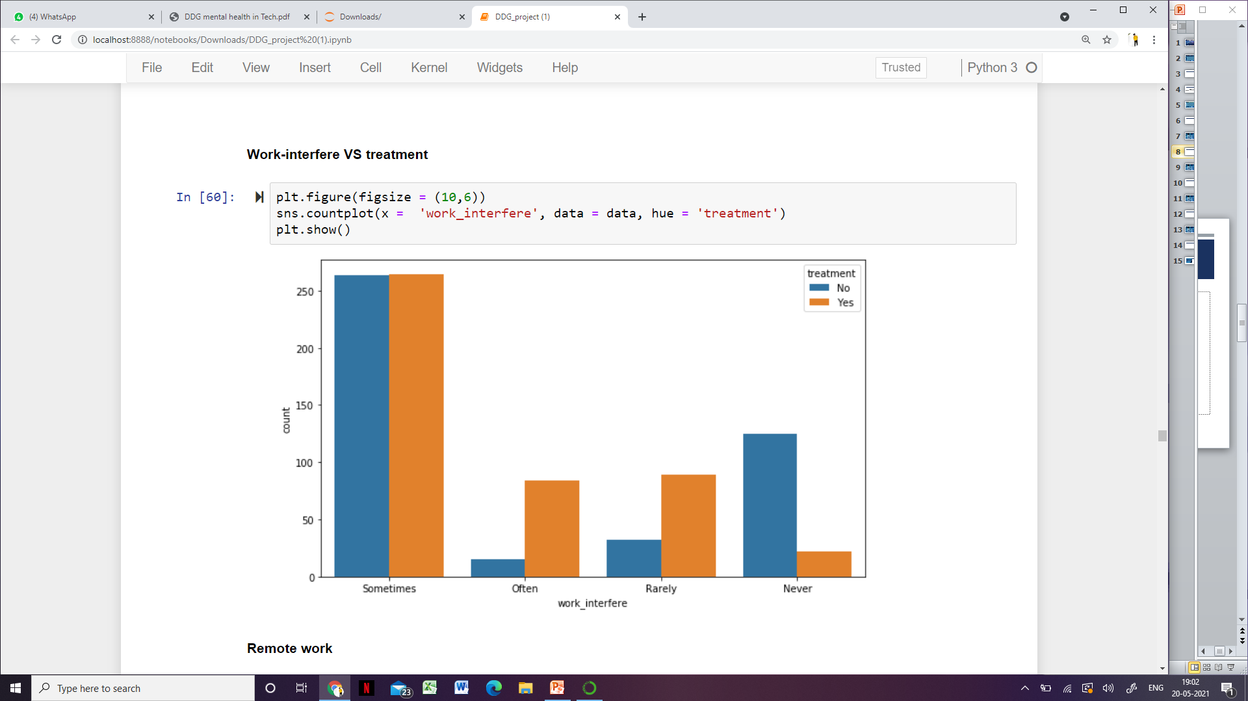
Work- interface VS Count
Next we compare the label treatment with the independent variable work interface. what we try to gain knowledge from this is that,
If you have a mental health condition, do you feel that it interferes with your work?
We analyze the answers given to this and compare it with the treatment
and we can see the workers how tend to feel that it will not affect
the work does not take the treatment and the workers who think it affects often tend to take the treatment.

Slide 11
Covid -19 survey methodology and analysis -
In the year 2020 covid – a biomedical diseases has serious physical and tremendous mental health implications as the rapidly spreading pandemic.
This is Survey is Conducted by- Naveen Kumara Raghavendra, Suresh Gopal
In between June 2, and August 30, 2020. The initially identified 6897 internal migrant workers through a snowball sample method.
We collected this data from ScienceDirect research article. to submit a paper in response to call for paper in the journal titled “Migration and health”. We have recorded 1350 response out of 6897 Sample through snowball sampling method.

Slide 12
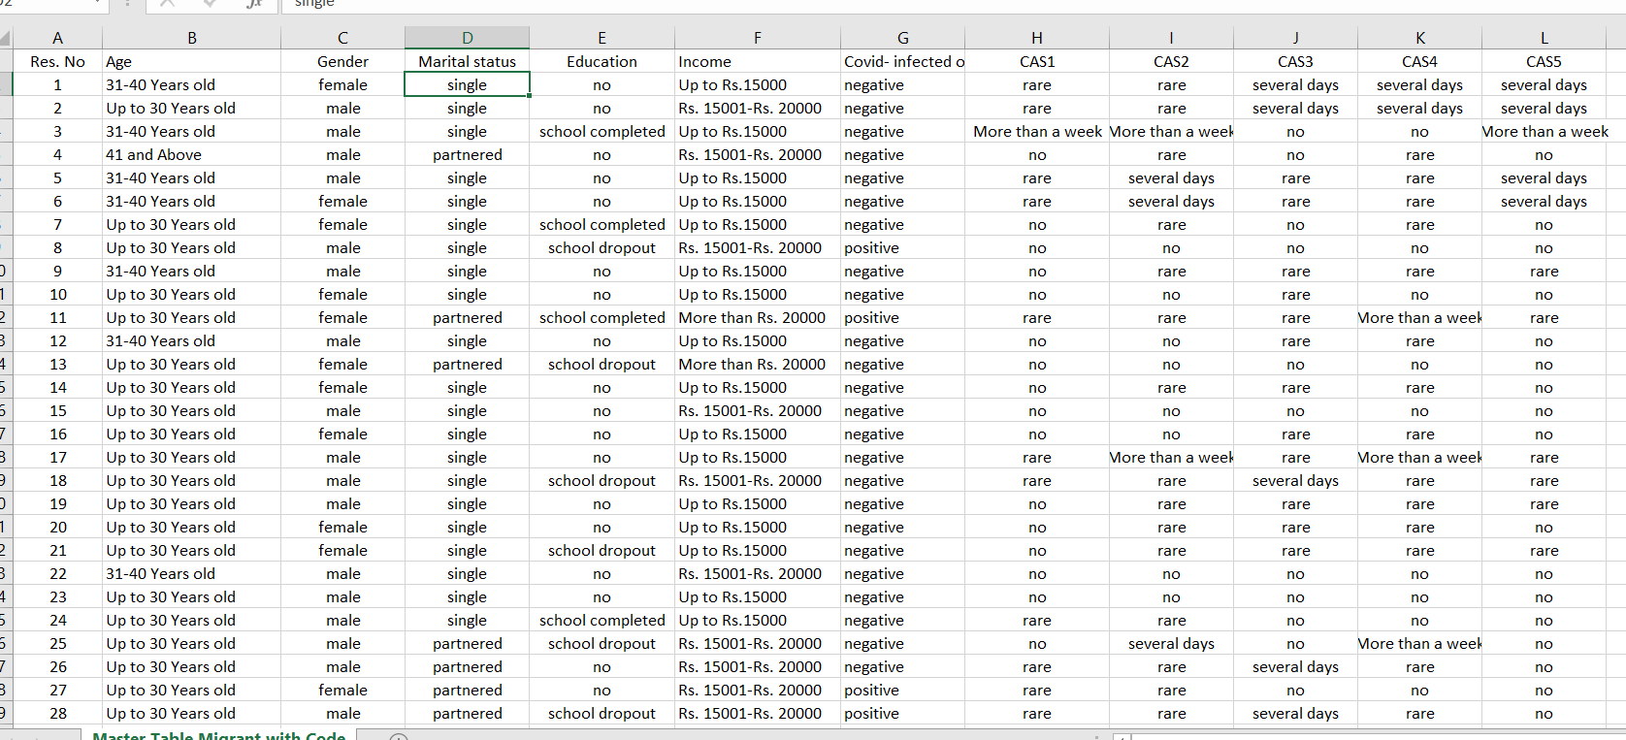
Covid – 19 data set

Slide 13
Description of data
Parameters of data collection – Respondents the data were chosen based on snowball sampling exclusively it was collected from internal migrant workers across the India the fact is here whether the location was affected by the pandemic or not.
Description of data collection - This is Survey was administered to internal migrant workers between June And August 2020 through telephonic interview from 1350 responses. The interview records the response and some of Questions were asked is below
1 ) – What is your Age
2) What is your Average Monthly Income
3) Were you tested positive for covid-19
4) CAS1 – Felt dizzy, lightheaded , or faint when read or listened to news about the coronavirus.

Slide 14
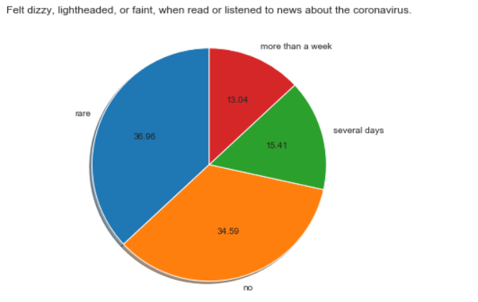
Analysis from survey
CAS 1 – felt dizzy, lightheaded, or faint when read
or listened to news about the coronavirus.
= To the response are people get to know about covid
Rare – 36.96 %
More than a week – 13.04
People don’t’ know- 34.59 %
Also analysis on tableau software –
DDG-Mental Health Survey | Tableau Public

Slide 15
Discussion on Mental health
The results from this study conclude that employees of primarily technology based
companies or organizationsface greater hardships when trying to discuss mental health issues at the workplace.
Another key finding from this series of models, albeit not surprising was that employee were more willing to discuss mental health issues with their suervisors
In the real life applications, technology baed companies or organizations shoud seek way to increasingly support mental health. And well-being of their workforce.

Slide 16

Mental health in Technology
Mental illness has historically been brushed under the carpet a treated as a taboo subject. Thankfully, times are changing. With many celebrities, and even royalty, sharing stories about their own mental health challenges, people are becoming more open about discussing depression, anxiety and mental illness. As society is becoming more enlightened about the subject of mental illness, technology is becoming an important part of providing solutions to preserve and improve mental health.
VR is a relatively new field, but progress is fast, and it is becoming
increasingly clear that virtual reality technology has an
important role to play in the field of mental health.
There is an app for everything these days, from shopping lists and
banking apps, to apps for productivity and weather forecasting.
Mood apps , online game, social media Instagram, Facebook etc.

Slide 17
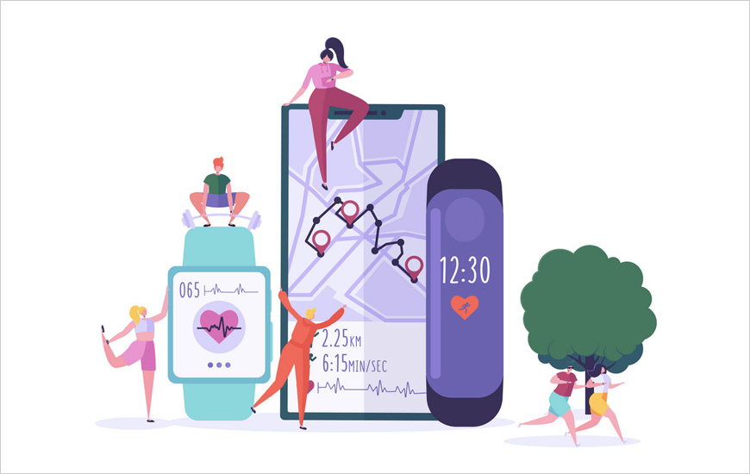
Benefits of Technology
Although not a panacea for the lack of mental health care, the use of technology can enhance and expand mental health care in areas, including rural areas, where providers are scarce.
technology is convenient. As the National Institute of Mental Health points out, treatment can take place in any place and at any time, 24/7.
As with any technology, there are also concerns about its use
Tips for individuals thinking about using technology
•Ask a trusted provider for a recommendation.
•Find information on the credentials and experience
of the app developer.
•Turn to the literature to see if there are any empirical
publications on the technology

Slide 18
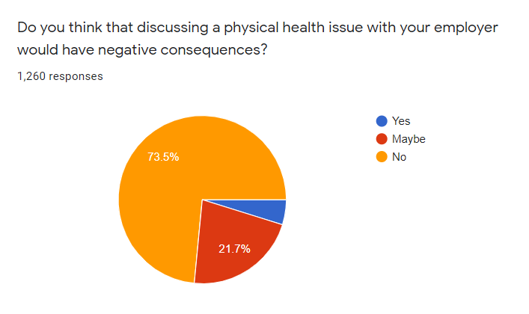
Description of Survey-
Mental health in the workplace is increasingly important for employees in the technology sector. Mental illness is the leading cause of sickness absence and incapacity benefits in most high-income countries .
There is questions like such as do you think that discussing a physical health issue with your employer would have negative consequences
Responses are – there is 73 % employer have discuss about there physical and mental health issue.
14 % employer discussing about there health issue.

Slide 19

Policy recommendation on mental health
Equity: policy should not be amended with equality but should be amended with equity since the nation in built diverse people with diverse social and economic status. The vulnerable and the excluded people of a community should also be able receive services when they are in need.
Quality: the quality of the service should not vary to person to person every person in the society should receive the same health care treatment.
Governance and effective delivery: Before the national government making the policies for the nation it should have deep discussion with the sub governments such as panchayats, municipalities and state government since they deal with smaller section of the people in the society, they know what polices would be best for the people in that society.
Justice for all: every person in the society should receive the same amount of health care.
Maintenance of the sector: the government or the sub-governments should have to make a routine visit to the respective health care institute to make sure everything is going well

Slide 20
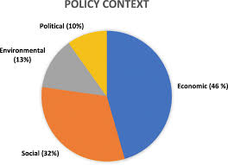
Policy recommendation at local government and State government
The local government consists of cities towns villages which are governed by counsellors or the head of the village panchayts.
The role of local government is important for making policies since they a govern a small amount of people a will know what will be appropriate decision that will be helpful for the people
For example the covid migrant survey we know that the migrant were suffering from mental illness due to factor income and covid cases, the local government could make policy to improve the salary or make provision for them to get a higher jobs. They can provide food for the migrants whose income are near poverty line and who have lost their job in the covid pandemic.
The role of these government is important for making policies since they a govern all the local government these government can collect information from the local government about the status of the people in their region and make plans accordingly.
For example the covid migrant survey we know that the migrant were suffering
from mental illness due to factor income and covid cases, the state/national
government van execute refugee camps for these migrants to provide food and
medical facilities for the migrants which can help them to improve their mental health

Slide 21
Conclusion
While working on this project we were completely focused on the topic that is mental illness, and as it has become a need to communicate about mental health openly to understand a person like what and how he is feeling whether he/she is going through any mental illness like anxiety, feeling dizzy, feels often disinterested or stressed.
doing analysis of OSMI survey we came to understand that multiple mental health issues mostly occurred under age of 25-40. d covid-19 survey conducted in June-August 2020 and came to understand that during lockdown period
But for those people who don’t share their issues for such people software developers(technology) have created many applications like help with anxiety, mood apps, PIP device (give immediate feedback about stress levels) which might help them. We learnt government policies made for people facing mental health challenges, what all points should be kept in mind while making or processing any policy.

Slide 22

Thank you..

